Slide 1
MantTest Distributed Architecture
Iskander Sierra
JG Ingenieros S.A.

Slide 2
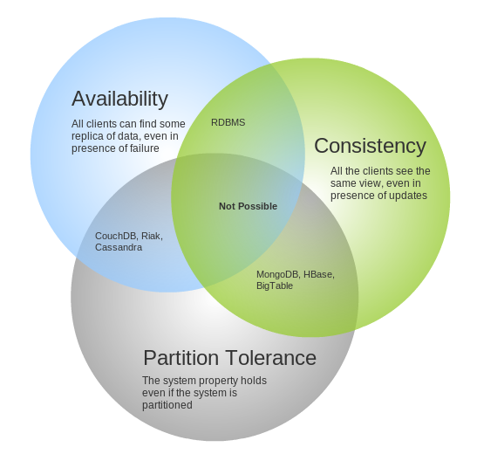
CAP Theorem
The CAP theorem states that it is impossible for a distributed computer system to simultaneously provide all three of the following guarantees:
Consistency: all nodes see the same data at the same time
Availability: every request receives a response about whether it succeeded or failed
Partition tolerance: the system continues to operate despite arbitrary partitioning due to network failures

Slide 3
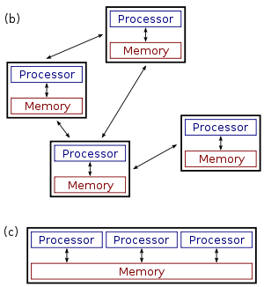
Distributed Computing
Several autonomous nodes with their own local memory and processors
The nodes communicate with each other by message passing
The system has to tolerate failures in individual nodes
The topology of the system is not known in advance and can change anytime
Each node has only a limited and incomplete view of the system
Distributed system
Parallel system

Slide 4
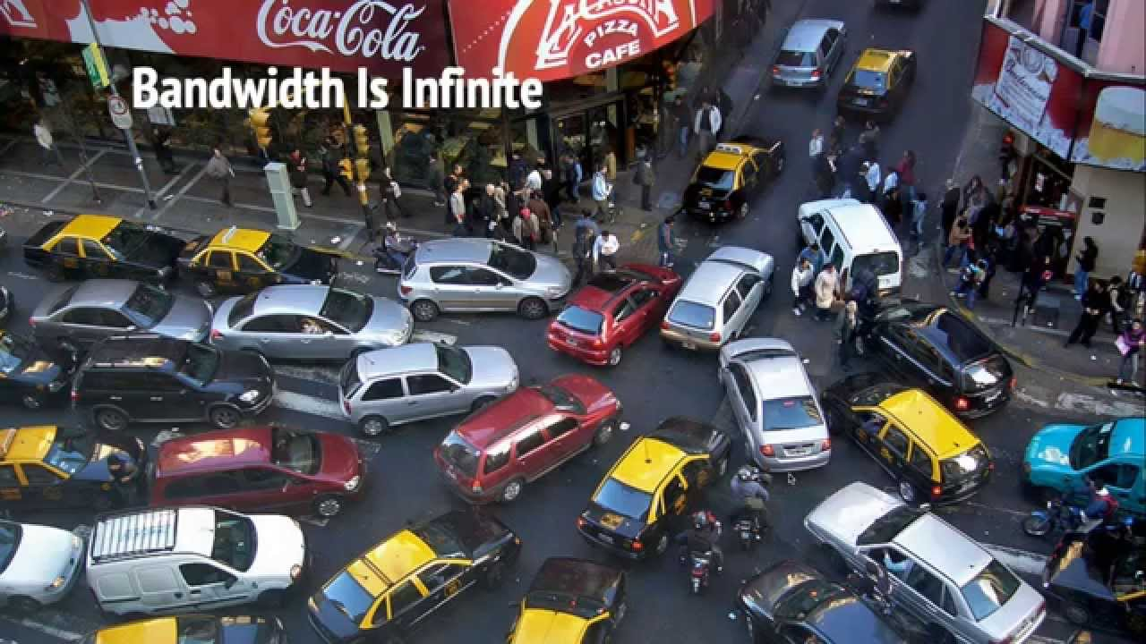
Distributed Computing
Fallacies
The network is reliable
Latency is zero
Bandwidth is infinite
The network is secure
Topology doesn’t change
There is one administrator
Transport cost is zero
The network is homogeneous
https://pages.cs.wisc.edu/~zuyu/files/fallacies.pdf

Slide 5
Distributed Computing
Architectural Styles
Client/Server: Segregates the system into two applications, where the client makes requests to the server. In many cases, the server is a database with application logic represented as stored procedures.
Domain Driven Design: An object-oriented architectural style focused on modeling a business domain and defining business objects based on entities within the business domain.
Layered Architecture: Partition the concerns of the application into stacked groups (layers).
Service-Oriented Architecture (SOA): Refers to applications that expose and consume functionality as a service using contracts and messages.

Slide 6
Distributed Computing
Architectural Styles
Message Bus: An architecture style that prescribes use of a software system that can receive and send messages using one or more communication channels, so that applications can interact without needing to know specific details about each other.
N-Tier / 3-Tier: Segregates functionality into separate segments in much the same way as the layered style, but with each segment being a tier located on a physically separate computer.
Object-Oriented: A design paradigm based on division of responsibilities for an application or system into individual reusable and self-sufficient objects, each containing the data and the behavior relevant to the object.

Slide 7
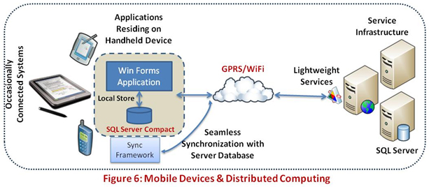
Distributed Computing
Challenges
Identity and Access Management
Load Balancing and Concurrency
Security
Governance and Monitoring
Message Exchange Models
Mobile Devices
https://msdn.microsoft.com/en-us/library/cc949110.aspx

Slide 8
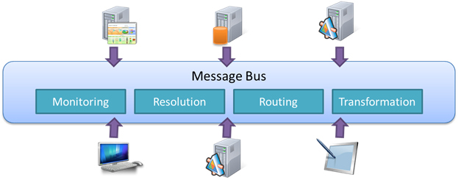
Message Oriented Architecture
Messages: Unit of data exchange
Queues: Asynchronous transport mean for a consumer
Routing: Location transparency of consumers and producers
Services: Produce and consume messages
Integration: Allows transforming messages for decoupling

Slide 9
Message Oriented Architecture
Examples of messages
A message is any relatively short data unit which conveys some information for the system producing/consuming it
42
“What is the answer to the Ultimate Question of Life, the Universe, and Everything"
<LogError>Error on remote system</LogError>
{ command: “create-order”, zone: “East Building”, date: ...}
[... binary content ...]

Slide 10
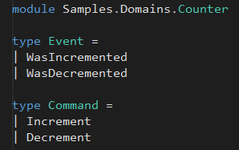
Message Oriented Architecture
Examples of messages
Counter.fs
42
-
41
+
-
+
Decrement
View (41)
Update (42, Increment)
http://elm-lang.org/examples
(41, WasDecremented)

Slide 11
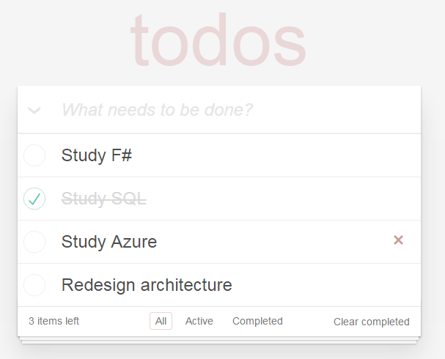
Message Oriented Architecture
http://todomvc.com/examples/elm/
Todo.elm
type Action
= NoOp
| UpdateField String
| Add
| UpdateTask (Int, Task.Action)
| DeleteComplete
| CheckAll Bool
| ChangeVisibility String

Slide 12
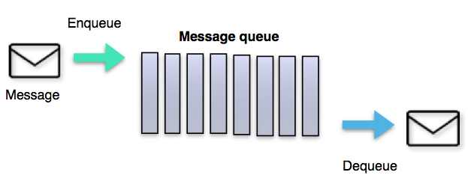
Message Oriented Architecture
Message queues
A queue is a line of things waiting to be handled - in sequential order starting at the beginning of the line. A message queue is a queue of messages sent between applications. It includes a sequence of work objects that are waiting to be processed.

Slide 13
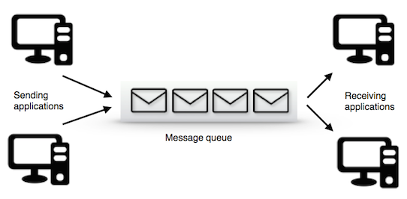
Message Oriented Architecture
Message queues features
Decoupling
Persistence
Scalability
Security
Delivery policies
Batching
Priority
Purging
Routing
Auditing

Slide 14
Domain Driven Design
An approach to software development for complex needs
Context: The setting in which a word or statement appears that determines its meaning (part of specification)
Ubiquitous Language: Natural language words and statements to communicate experts with development team
Domain: A sphere of knowledge, influence or activity (part of solution)
Model: Abstractions that describes selected aspects of a domain
Building blocks: Entity, Value Object, Aggregate, Domain Event, Service, Repository, Factory
Eric Evans
https://msdn.microsoft.com/en-us/library/ee658117.aspx#DomainModelStyle

Slide 15
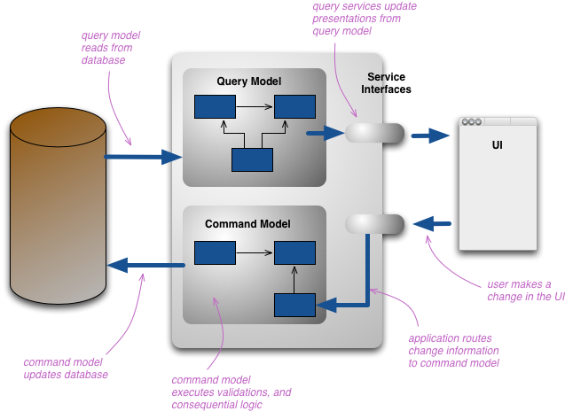
CQRS
CQRS is simply the creation of two objects where there was previously only one. The separation occurs based upon whether the methods are a command or a query

Slide 16
CQRS
Responsibility Segregation
Task based UI
Event Sourcing
Messaging Patterns
Eventual Consistency
Greg Young
http://codebetter.com/gregyoung/2010/02/16/cqrs-task-based-uis-event-sourcing-agh/

Slide 17
Functional Programming
Is a programming paradigm that treats computation as the evaluation of mathematical functions and avoids changing state and mutable data
Characteristic | Imperative | Functional
Focus | How to perform tasks and track change in state | What information is desired and what transformations are required
State change | Important | Non-existent
Order of execution | Important | Low importance
Primary flow control | Loops, conditionals and function calls | Function calls
Primary manipulation unit | Instances of structures and classes | Functions and data collections

Slide 18
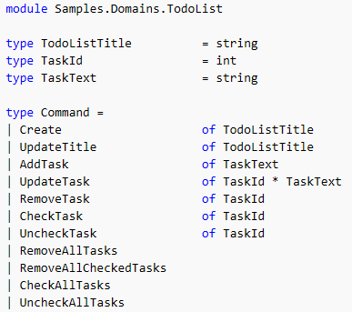
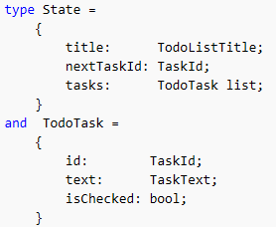
Functional Programming

Slide 19
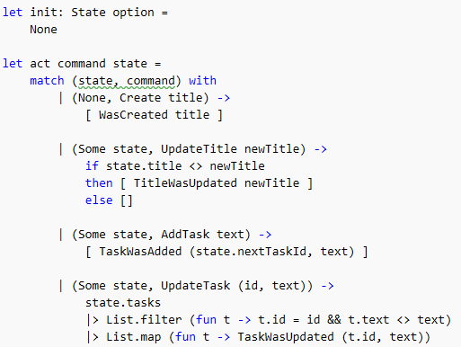
Functional Programming

Slide 20





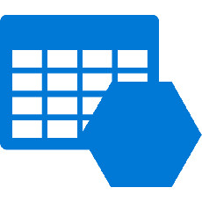
Data Persistence
Data-Model
Relational database
Document database
Key-Value store
Blob store
Table store
Column store
Index store
Graph store
Event store
Hadoop

Slide 21
Data Persistence
On-line Transaction Processing
Operational data
Control and run fundamental business tasks
Source of business facts
Short and fast updates
Simple queries and short results
Requires small space
Backup critical
On-line Analytical Processing
Consolidation data
Planning, problem solving and decision support
Multidimensional views
Complex stream/batch updates
Complex indexed queries
Large space, data duplication
Derived from OLTP system

Slide 22
Actors Model

Slide 23
Data Visualization

Slide 24
HTTP and REST

Slide 25
Azure IaaS and PaaS

Slide 26
Source Control and Continuous Integration
Git
GitFlow
DevOps
Automation

Slide 27
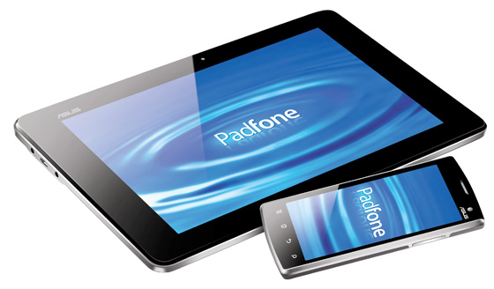



Distributed Application Architecture
Targeted Apps
Mobile
Distributed
Application
Services
Communication Interface
Power Apps
Desktop / Web

Slide 28
Server-Side Message-Oriented Architecture
…
API APP
Commands
Command
Processing
Cluster
Command queue
Commands
Business
Decision
Making
Client
Notific.
…
Events
Event Hub
Messages
View
Projection
Cluster
API APP
Queries
Data
Updates

